Slide 1


Slide 2
A. BASIC INFORMATION
Title of Research
Home Automation & Security System

Slide 3
II. Proponent(s)
Researchers:
Alcazar, Mary Grace B.
Espina, Joycee Ann L.
Lee, Krissa Mae F.
Montemayor, Cedric Jan C.

Slide 4
III. Project Site
Montemayor’s Residence
San Roque, Sogod, Southern Leyte
IV. Project Duration
3 months

Slide 5
V. Target Beneficiaries
Communities, Students
VI. Project Cost
P 10,855.00 (actual cost, do not include the damages & unused material)

Slide 6
Abstract

Slide 7
B. INTRODUCTION
A Smart home system focuses on controlling home electronic devices whether you are inside or outside your home. Smart Home gives an individual the ability to remotely or automatically control things around the home. A Smart home is a device or instrument designed to perform a specific function, especially an electrical device, such as a refrigerator, for household use. The task can be performed by on bases of sensor data. which will take itself decision and action to perform.

Slide 8
B. INTRODUCTION
* In a situation where there is high level of larceny, there is need for better security system. Security is a major focus of smart home systems. Advanced smart security systems can notify you remotely if there has been an intrusion, detect strangers trying to enter your home, provide room-by-room surveillance, and so much more. This tends to apply the accessible GSM network, Wi-Fi network, mobile phone and electronics circuit to attain an automated system which is programmed to work as a thinking device to accomplish this research. To secure it against robbery or any related crime, security system is required not only to detect but also preempts hazards.

Slide 9
OBJECTIVES
1. To develop a home automation and security system; using Arduino being remotely controlled by any phone using Text Messaging and Push button;
2. To create an upgradable home automation and security system; and
3. To establish the benefits of installing home automation and security system.

Slide 10
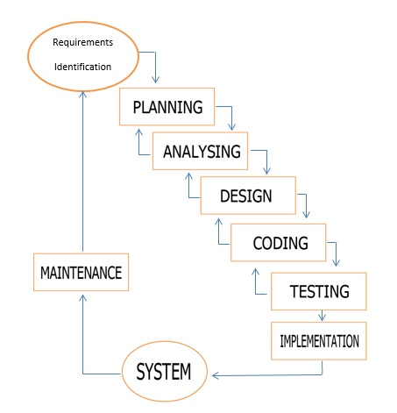
METHODS
Experimental Model

Slide 11
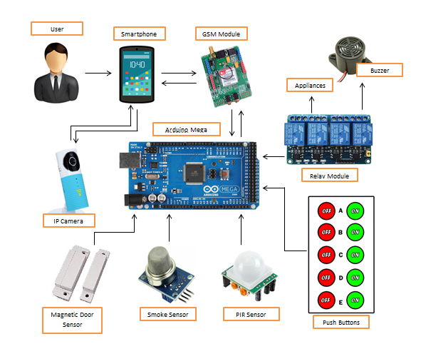
METHODS
Architectural Design of the System

Slide 12
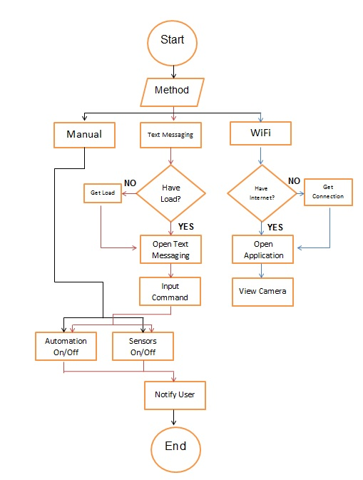
METHODS
Procedural Design

Slide 13
Command | Function
1. Push Button No.1 | Turns on Light 1
2. Push Button No.2 | Turns off Light 1
3. Push Button No.3 | Turns on Light 2
4. Push Button No.4 | Turns off Light 2
5. Push Button No.5 | Turns on Light 3
6. Push Button No.6 | Turns off Light 3
7. Push Button No.7 | Turns on all the lights simultaneously
8. Push Button No.8 | Turns off all the lights simultaneously, turns off the magnetic door and PIR sensors,
9. Push Button No.9 | Turns on all the sensors (PIR, Smoke Sensor and Magnetic door sensor)
10. Push Button No.10 | Turns off the Magnetic door sensor
Functions of the Push buttons

Slide 14
Command | Function
1. #a1 | Turns on Light 1
2. #a0 | Turns off Light 1
3. #b1 | Turns on Light 2
4. #b0 | Turns off Light 2
5. #c1 | Turns on Light 3
6. #c0 | Turns off Light 3
7. #d1 | Turns on all the lights simultaneously
8. #d0 | Turns off all the lights simultaneously, turns off the magnetic door and PIR sensors,
9. #s1 | Turns on all the sensors (PIR, Smoke Sensor and Magnetic door sensor)
10. #s0 | Turns off the Magnetic door sensor
List of Commands in the text messaging method

Slide 15
Command | Reply
1. #a1 | Someone Recently Turned on Light1
2. #a0 | Someone Recently Turned off Light1
3. #b1 | Someone Recently Turned on Light2
4. #b0 | Someone Recently Turned off Light2
5. #c1 | Someone Recently Turned on Light3
6. #c0 | NONE
7. #d1 | NONE
8. #d0 | NONE
9. #s1 | NONE
10. #s0 | NONE
Reply function of the GSM Module in the Specific Commands

Slide 16
Sensor | Text Message
1. Magnetic Door Sensor | Someone Recently opened the door!
2. PIR Sensor | Someone Recently passed by!
3. Smoke Sensor | Smoke is detected
List of Text Messages sent by the GSM when a specific sensor detects

Slide 17
Conclusions
Advantages of the System:
1. Sensors used have high sensitivity and are easy to handle.
2. Providing maximum automation.
3. Low maintenance and low power consumption.
4. The system is more compact compared to the existing ones, hence is easily portable.
5. Can be easily modified for improving the setup and adding new features.
6. Time saving.
7. Provides a user-friendly interface hence will have a greater acceptance by the technologically unskilled workers.
8. Feedback for specific command is given by system.
9. Malfunctioning of single sensor will not affect the whole system.
Disadvantages of the System:
1. No self-test system to detect malfunction of sensors.
2. Requires uninterrupted power supply.
3. System doesn’t have Decision making capacity.

Slide 18
Low Cost System
P = I*V
2 Ampere * 12 Volts
=24 Watts
P = I*V
2 Ampere * 5 Volts
=10 Watts
Cost per hour = Rate x (appliance wattage / 1000)
Cost per hour = P10.50 x (34 watts / 1000)
Cost per hour = P10.50 x (.034 kilowatt)
Cost per hour = P 0.357 per hour

Slide 19
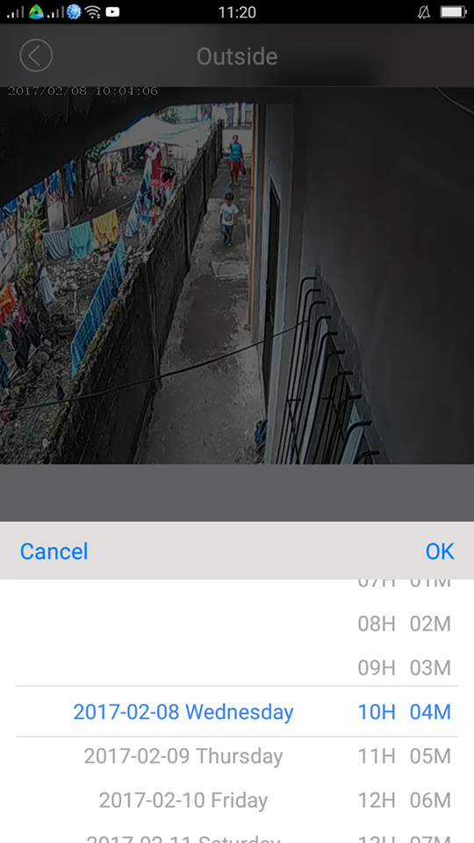
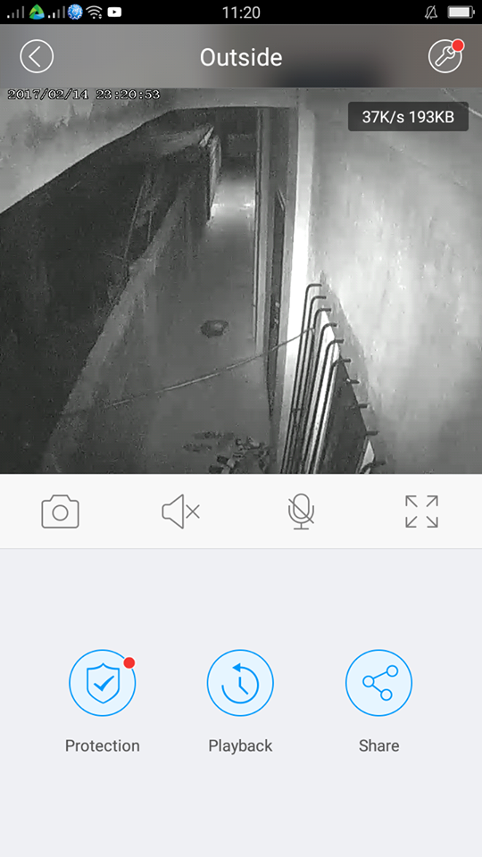
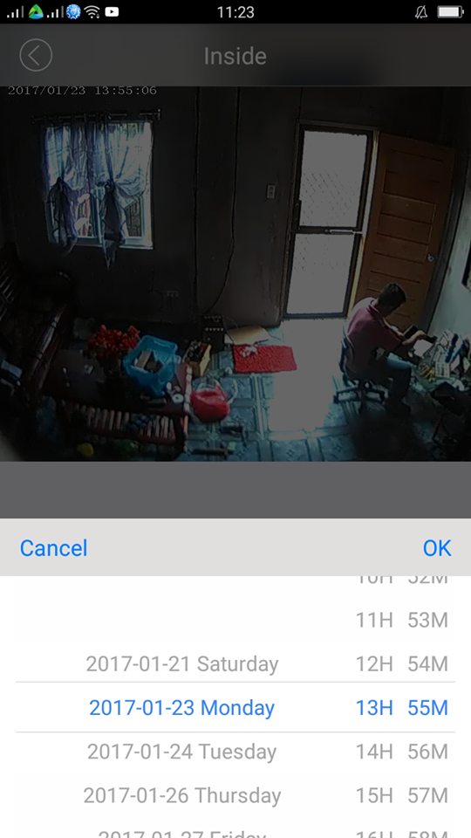
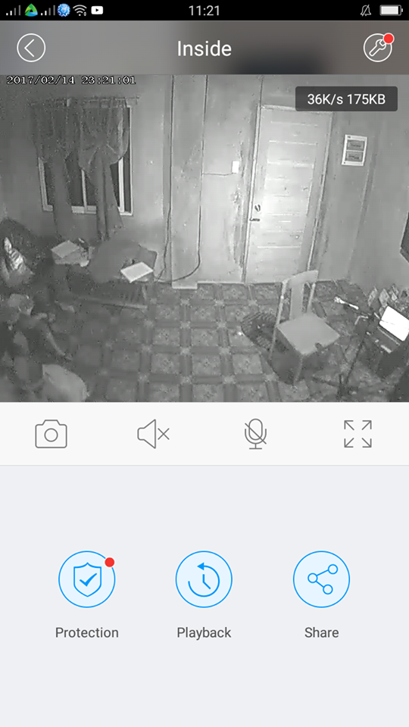
Monitoring in IP Camera

